Slide 1
Electric Vehicle Sales by State in India

Slide 2
ABOUT project
This project centered on the acquisition preparation of a comprehensive dataset detailing electric vehicle (EV) adoption across India. The primary objective was to transform raw, web-scraped data from the Clean Mobility Shift portal into a pristine, analysis-ready resource. This involved a rigorous data cleaning process, including the removal of null values and structural inconsistencies, to ensure high data integrity and reliability.
The resulting dataset is a powerful foundation for data-driven exploration into India's evolving EV landscape. By providing a clean and reliable data source, this project directly supports strategic initiatives in market analysis, infrastructure planning, and policy development within the dynamic Indian EV sector.

Slide 3
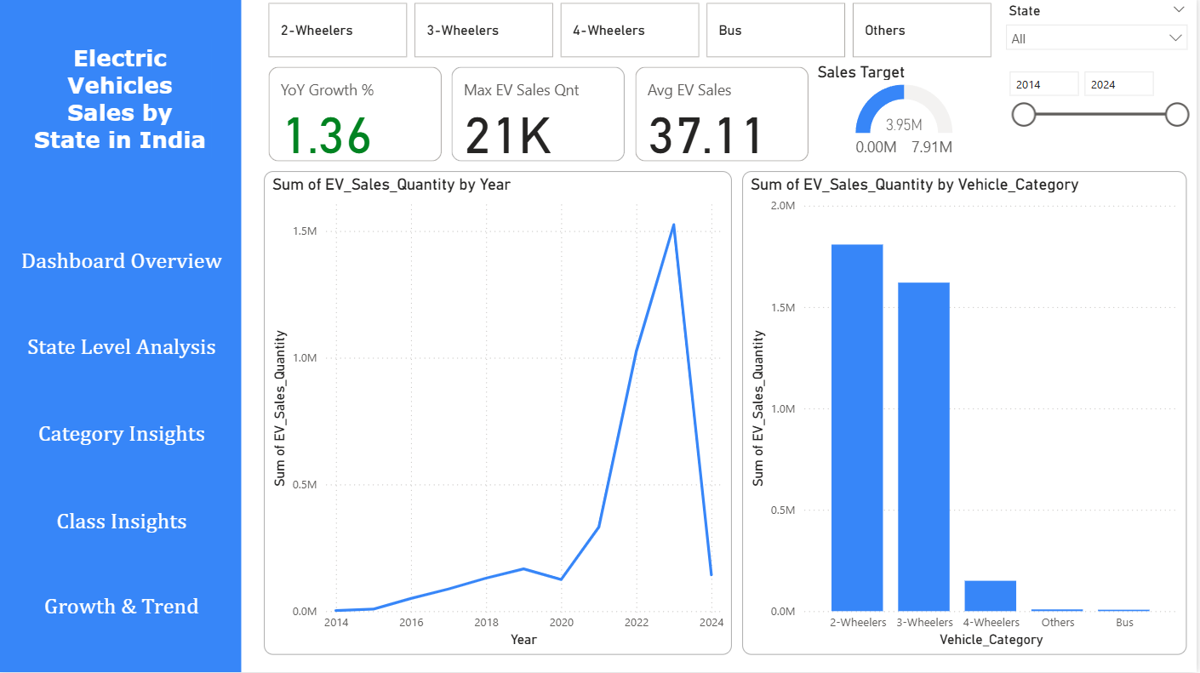
Dashboard Overview
This executive overview provides a high-level health check of India's EV market. The KPI cards deliver an immediate performance snapshot, highlighting the market's scale with 4M total sales and its positive momentum with a 1.36% YoY growth. These figures set the baseline for all further analysis.
The line chart tracking annual sales is critical for visualizing the market's long-term trajectory. It clearly illustrates the pivotal moments of acceleration, showing the transition from early adoption to mass-market growth over the past decade and confirming the overall positive trend.
The bar chart for sales by vehicle category offers an instant market share comparison. It visually establishes the dominance of key segments like 2-wheelers and 3-wheelers, immediately directing strategic focus towards the sectors driving the bulk of national volume.

Slide 4
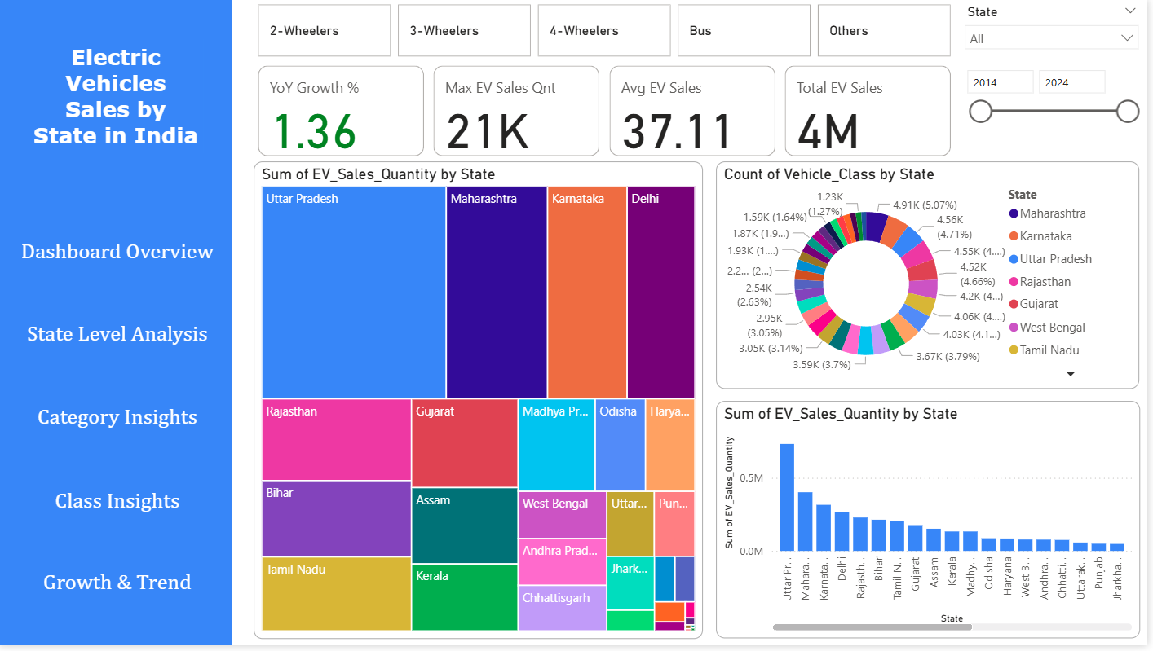
State-Level Analysis
Geographical distribution is key to understanding regional adoption. The choropleth map instantly visualizes sales concentration, identifying Uttar Pradesh and Maharashtra as the undisputed regional leaders. This provides a clear strategic map for prioritizing infrastructure and marketing efforts.
The horizontal bar chart measuring the count of vehicle classes per state adds a layer of market maturity to the volume data. It reveals that leading states also support a wider variety of models, indicating a more advanced and competitive EV ecosystem beyond just high sales numbers.
This allows for nuanced strategy, ensuring investments in high-volume states are matched with targeted model launches in diverse markets to capture their sophisticated consumer demand.

Slide 5
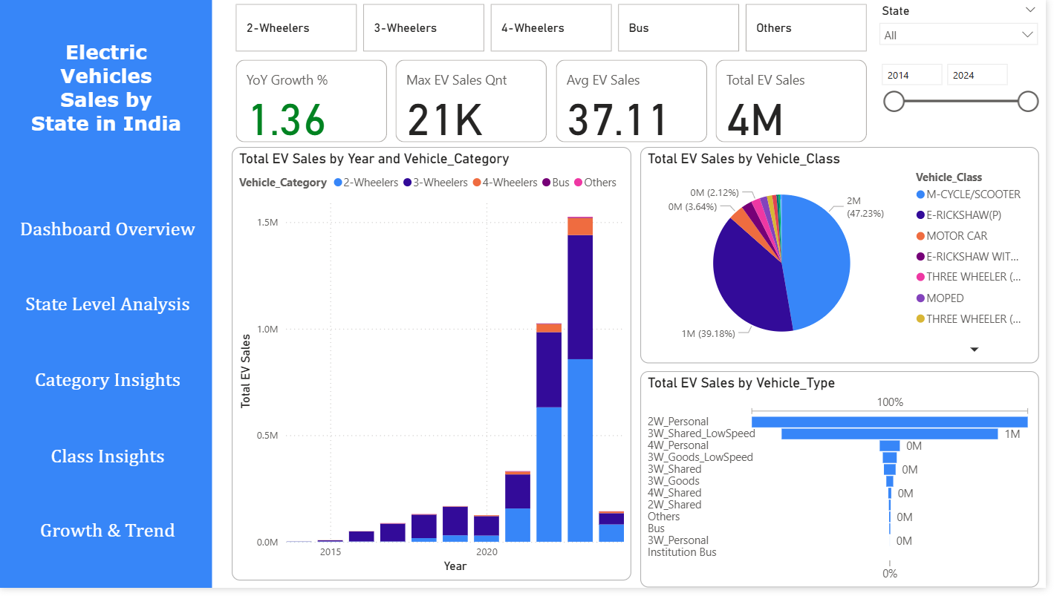
Vehicle Category Insights
This page offers a detailed structural analysis of the market. The stacked column chart breaks down total sales by year and category, revealing the evolving market composition. It shows not just overall growth, but how the influence of each segment has shifted over time.
The pie chart provides a definitive market share breakdown by specific vehicle class. It quantifies the overwhelming dominance of categories like M-Cycles/Scooters, offering critical insight into the precise vehicle types that are resonating with Indian consumers.
The funnel chart effectively visualizes the sales concentration across major vehicle types. Its sequential format powerfully emphasizes the volume disparity, clearly illustrating the steep drop-off from high-volume 2-wheelers to niche segments, streamlining strategic prioritization.

Slide 6
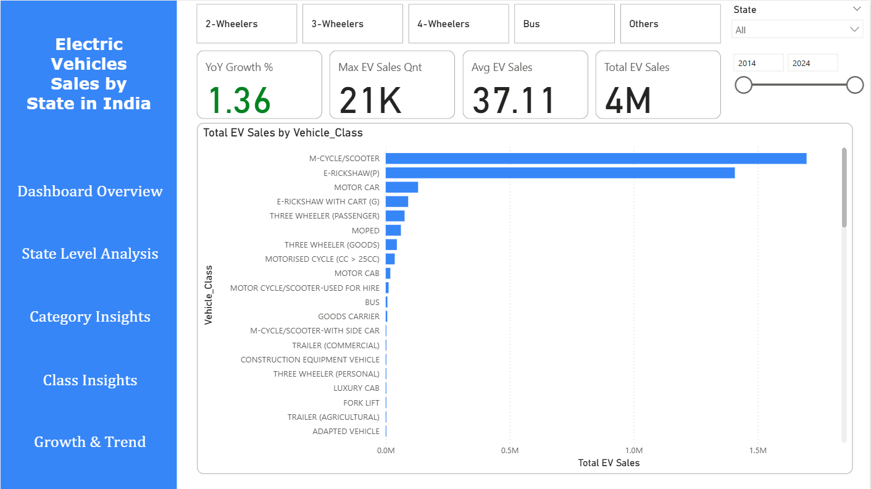
Vehicle Class Insights
The layout directly pairs each vehicle category with its core KPIs, enabling a rapid, side-by-side comparison of growth rates and sales performance to identify the most dynamic segments.
A detailed bar chart drills into the "Others" category, exposing specialized markets like commercial and agricultural vehicles. This analysis is crucial for identifying early-stage, high-potential niches that are often overlooked in broader category reviews.

Slide 7
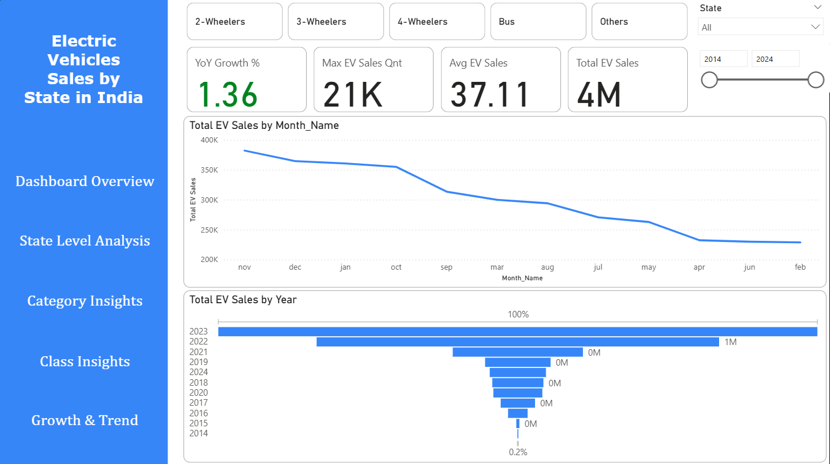
Growth & Trend Analysis
The monthly sales line chart is indispensable for identifying recurring seasonality, helping to correlate sales peaks with festivals, policy announcements, or fiscal year cycles.
The funnel chart applied to annual sales powerfully validates the market's exponential growth journey. Its shape makes the year-on-year expansion visually dramatic and undeniable, effectively communicating the long-term success of the EV transition to stakeholders.
By combining monthly and yearly views, we understand both the cyclical rhythms and the powerful underlying growth trend. This equips leadership to plan for short-term fluctuations while maintaining confidence in the long-term strategic direction.

Slide 8
Project OVERVIEW
Overview:
This Power BI dashboard transforms complex financial data into an interactive analytics platform for strategic decision-making. It provides a multi-dimensional view of sales performance, profitability, and commercial strategy across products, customer segments, and regions..
Key Insights from the Data:
Portfolio Optimization: A clear 80/20 rule was identified, where a small subset of products and segments contributed to the majority of overall profit.
Discount Strategy Analysis: High discount levels were frequently correlated with significantly lower profit margins, revealing a need for more strategic discounting policies.
Segment Performance: The Government segment generated high sales volume but demonstrated lower relative profitability compared to the Midmarket and Enterprise segments.
Strategic Categorization: Products were successfully classified into a BCG matrix, visually distinguishing Stars, Cash Cows, and products requiring strategic review.

